Slide 1
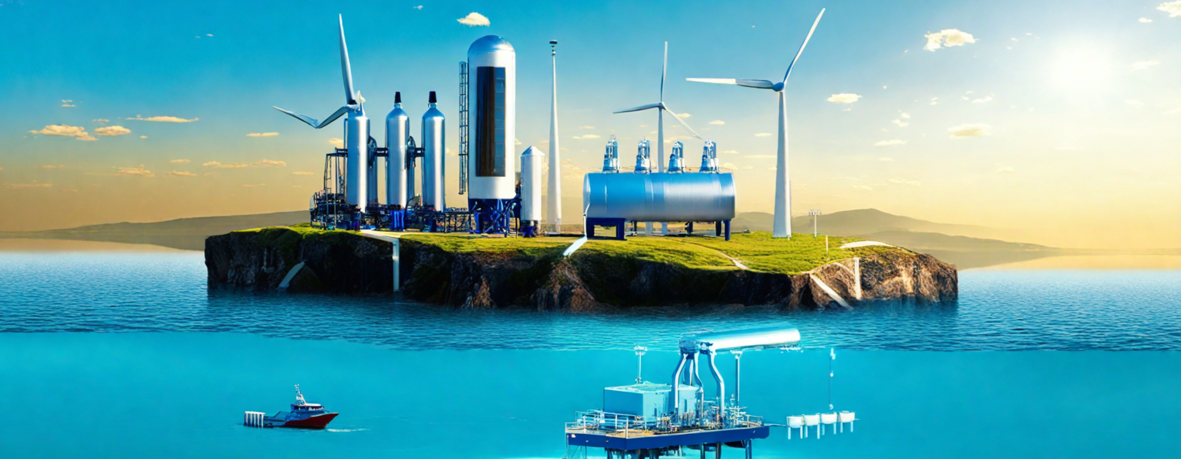
The delegated act on renewable fuels of non-biological origin in an integrated European energy system model
Island systems and grid integrated hydrogen production
27.06.2024 IAEE Leuven Oliver Linsel

Slide 2
Background
Hydrogen, when produced from renewable electricity via electrolysis, falls into the definition of „Renewable Fuels of non biological origin“ (RFNBO)
The Delegated Act defining RFNBOs is already in force (full applicability after 01.01.2028)
The regulation describes four options for the production of green hydrogen
Options | Name | Description
1 | Island Grid | Renewable electricity & hydrogen island grid
2 | Renewable Grid | 90% Renewable energies in the grid
3 | Additionality + Correlation | PPA + add capacity + temp. corr. + geo. corr.
4 | Curtailment avoidance | Use electricity if otherwise downward curtailed

Slide 3
Motivation & Research Question
The different options of the EU regulation target systemic effects to avoid undesired effects on the electricity system (e.g. incentivise capacity expansion)
On the other hand additional constraints are expected to increase costs and impact the interactions within the system
What are the effects of different aspects of the EU regulation regarding the distribution of hydrogen production (capacities) throughout Europe?
[*]
[*] https://energy.ec.europa.eu/news/renewable-hydrogen-production-new-rules-formally-adopted-2023-06-20_en

Slide 4
Scenarios
Scenario Nr | Name | Description
Scenario 1 | Base case | Only green hydrogen from renewable energy sources, no additional constraints
Scenario 2 | Island Grid | Renewable electricity & hydrogen island grid
Scenario 3 | Renewable Grid | 90% Renewable energies in the grid
Scenario 4 | Additionality + Correlation | PPA + add capacity + temp. corr. + geo. corr.
Scenario 5 | Delegated Act | All regulations according to Delegated Act for RFNBOs

Slide 5
Methodology – Base Model
EU
Electricity grid
Sector integrated European energy system model
    Electricity
    Hydrogen
Europe + neighbouring regions
One node per country/region
Year under review 2030
Cost-minimization investment model
Hydrogen representative for RFNBOs
CO2 tax & cap
Export Countries
Potential hydrogen transport system

Slide 6







Shipping
CO2 cap
Hydro
Storage
Li-Ion
battery
Terminal
Terminal
H2 Demand
Renewable Electricity Generation
Offshore
Wind
Onshore
Wind
Solar PV
Electrolysis
Hydrogen node
Biomass
Hydro
Renewable
Electricity node
Hydrogen node
Hydrogen
Grid
H2 OCGT
Spill-over
Non-Renewable Electricity Generation
Nuclear
Mixed
Electricity node
OCGT
Fuel Cell
H2 storage
H2 Demand
CCGT
Coal & Oil
Electricity
Grid
H2 Engine
Electricity Demand
[1] EU, 2018https://eur-lex.europa.eu/legal-content/EN/TXT/HTML/?uri=CELEX:02018L2001-20231120

Slide 7
Potential transport system
[2] Linsel, O. & Bertsch, V. (2023) A flexible approach to GIS based modelling of a global hydrogen transport system. International Journal of Hydrogen Energy. https://doi.org/10.1016/j.ijhydene.2023.08.199

Slide 8


Methodology – Option 1 Island Grid
Island Grid
Offshore
Wind
Electrolysis
Distinctive modelling of island grids for each bidding zone
Same grid node production and smart meter balancing covered by this
Onshore
Wind
Hydrogen
Grid
Solar PV
Renewable Electricity node
Hydrogen node
Smart
Meter
Mixed electricity
Grid
Li-Ion
battery

Slide 9
Base energy system configuration
Shipping
CO2 cap
Hydro
Storage
Li-Ion
battery
Terminal
Terminal
H2 Demand
Additional Renewable Electricity Generation
Offshore
Wind
Onshore
Wind
Electrolysis
Hydrogen node
Solar PV
Renewable
Electricity node
Hydrogen node
Hydrogen
Grid
H2 OCGT
Spill-over
Existing Electricity Generation
OCGT
Coal & Oil
CCGT
Mixed
Electricity node
Fuel Cell
H2 storage
H2 Demand
Offshore
Wind
Onshore
Wind
Solar PV
Electricity
Grid
H2 Engine
Hydro
Biomass
Nuclear
Electricity Demand
[1] EU, 2018https://eur-lex.europa.eu/legal-content/EN/TXT/HTML/?uri=CELEX:02018L2001-20231120
Notes:
Redirect Re-electrification to mixed electricity node?

Slide 10
Results

Slide 11
Long-term avg. marginal costs
Electricity marginal costs [€/MWh]
Hydrogen marginal costs [€/MWh]

Slide 12
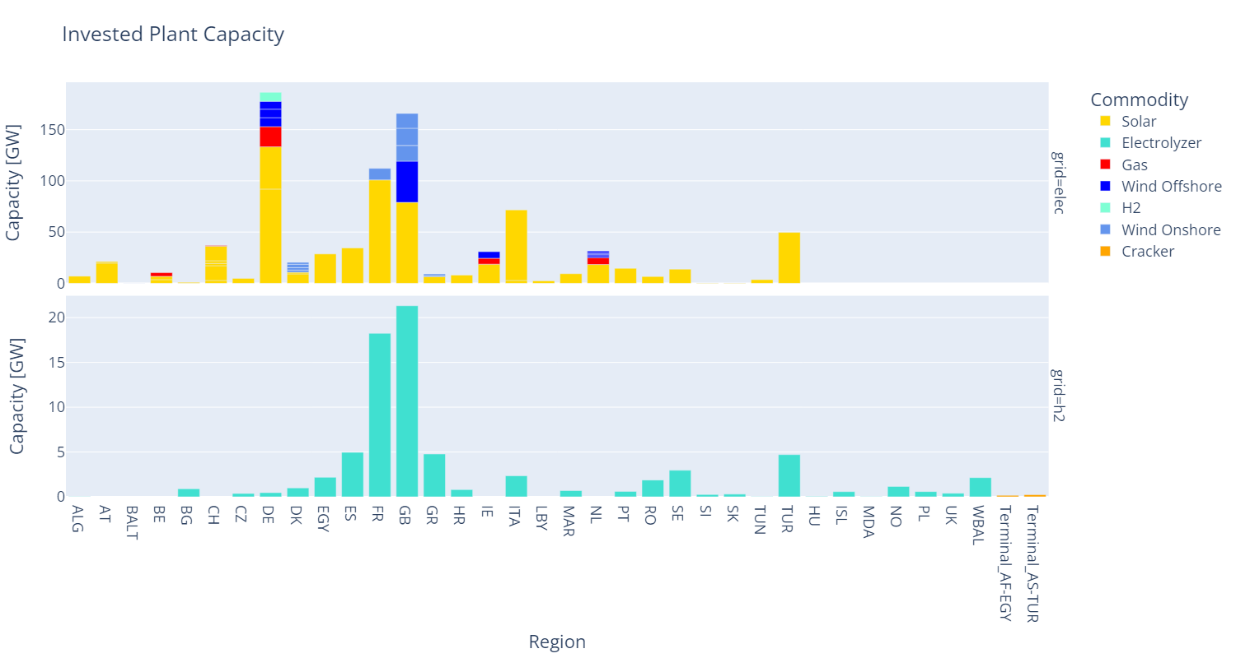

Slide 13
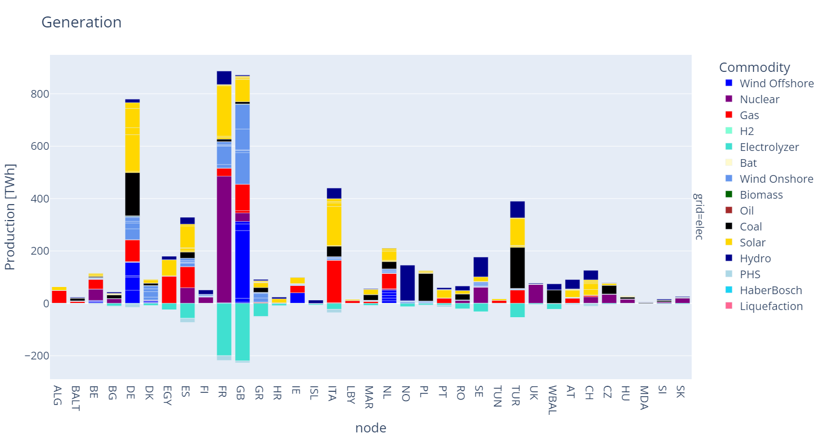

Slide 14
Transport and production results

Slide 15
Comparison
Base Case
Island Grid

Slide 16
Comparison hydrogen marginal costs
Base Case hydrogen marginal costs [€/MWh]
Island Grid hydrogen marginal costs [€/MWh]

Slide 17
Comparison transport and production results
Base Case
Island Grid

Slide 18
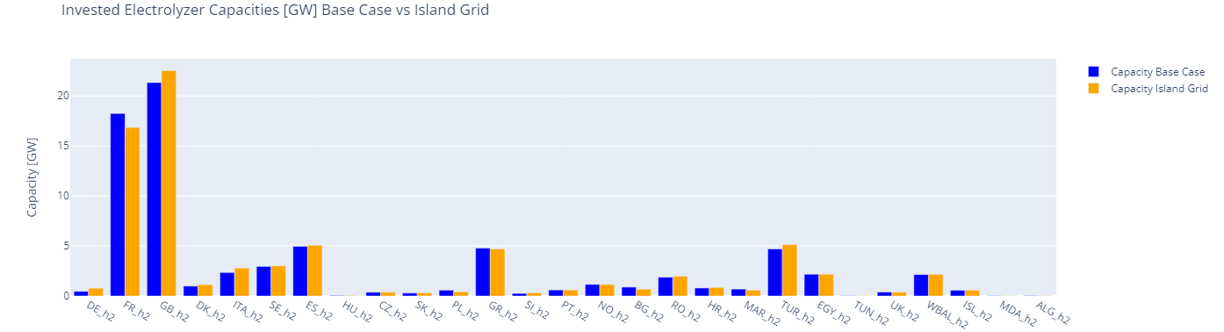
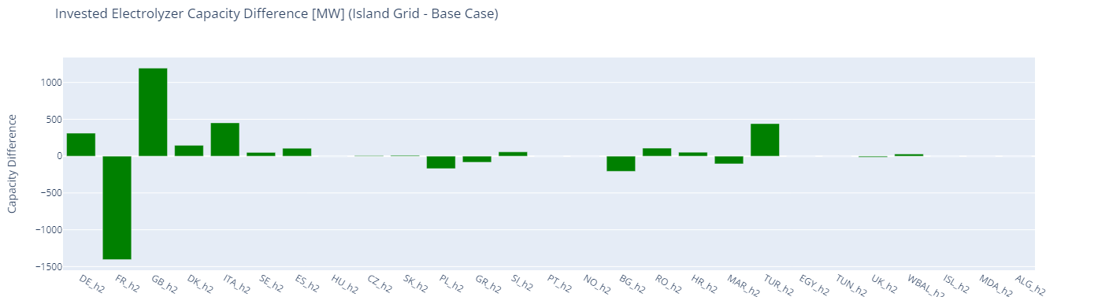
Increasing WACC

Slide 19
Preliminary findings
Total costs:
Island grid option has 4.7% higher costs than Base Case
Electrolyzer capacities:
Mostly small differences
France has about 1.4 GW smaller electrolyzer capacity in Island Grid scenario
  Nuclear capacity relieves RE capacities
Great Britain has about 1.2 GW bigger electrolyzer capacity in Island Grid scenario
  More favourable RE conditions

Slide 20
Next steps
Further validating of the model
Introducing the constraints for the next options
    Renewable Grid
    Additionality and Correlation
    Full Delegated Act
  Further Analysis

Slide 21
Thank you
Questions and Suggestions?

Slide 22





CONTACT
Oliver Linsel
Ruhr-Universität Bochum
Chair of Energy Systems & Energy Economics
Universitätsstr. 150
44801 Bochum, Germany
Phone: +49 15784043869
oliver.linsel@ee.rub.de | www.ee.rub.de

Slide 23
Backup

Slide 24
Background & Motivation
The Green Deal the most comprehensive legislative climate policy packages to date
New EU regulation of what is considered green hydrogen
Hydrogen, when produced from renewable electricity via electrolysis, falls into the definition of „Renewable Fuels of non biological origin“ (RFNBO)
In the context of the Renewable Energy Directive II (REDII) this regulations was set in place as a Delegated Act (DA)
The regulation is already in force and will reach full applicability after a transition period by 01.01.2028
The regulation describes four options for the production of green hydrogen
[1]
[1] https://eur-lex.europa.eu/legal-content/EN/TXT/?uri=CELEX%3A32023R1184&qid=1704969010792

Slide 25
Current state of research
Schlund & Theile, Simultaneity of green energy and hydrogen production: Analysing the dispatch of a grid-connected electrolyser, 2022, DOI: 10.1016/j.enpol.2022.113008
    Behaviour of island grids especially regarding simultaneity
    Trade-off between economic viability, full load hours and indirect emissions to produce electricity-based hydrogen
Ruhnau & Schiele, Flexible green hydrogen effect of relaxing simultaneity requirements, 2023, DOI: 10.1016/j.enpol.2023.113763
    Simultaneity requirements regarding individual projects
    Hourly simultaneity requirement increases the cost of the produced hydrogen due to an increased need for storage
Langenmayr & Ruppert, Renewable origin, additionality, temporal and geographical correlation – eFuels production in Germany under the RED II regime, 2023, DOI: 10.1016/j.enpol.2023.113830
    Compare RFNBO production in Germany for 2025 and 2030 with and without the REDII regime
[2] https://www.ffe.de/en/publications/how-is-green-hydrogen-defined-according-to-the-eus-delegated-act/
[3] Schlund, David; Theile, Philipp, Simultaneity of green energy and hydrogen production: Analysing the dispatch of a grid-connected electrolyser, Energy Policy 166, 2022, DOI: 10.1016/j.enpol.2022.113008
[4] Ruhnau, Oliver; Schiele, Johanna, Flexible green hydrogen: The effect of relaxing simultaneity requirements on project design, economics, and power sector emissions, Energy Policy 182, 2023, DOI: 10.1016/j.enpol.2023.113763
[5] Langenmayr, Uwe; Ruppert, Manuel, Renewable origin, additionality, temporal and geographical correlation – eFuels production in Germany under the RED II regime, Energy Policy 183, 2023, DOI: 10.1016/j.enpol.2023.113830

Slide 26
Methodology – Option 2 Renewable Grid
Renewable Energies
Hydrogen
Grid
Outlook to the energy systems 2030
Which bidding zones reach > 90% renewable share or CO2-emissions < 64.8 gCO2eq/kWh?
    Presolve without hydrogen demand
    These bidding zones will be free from constraints, while the others will be bound by regulation
Offshore
Wind
Onshore
Wind
Renewable Electricity node
Biomass
Solar PV
Hydro
Power
Electrolysis
> 90%
Fossil
Low-Carbon
Electricity
Grid
Coal
Power
CCGT
Nuclear
Power
< 10%
Lignite
Power
OCGT
Mixed Electricity node

Slide 27


Methodology – Option 3 Additionality & Correlation
PPA will be regarded as given – no modelling
Additionality will be ensured be defining distinct investment units and a distinct “green” electricity commodity
Temporal correlation while storages are permitted
Day-ahead-price constraint or CO2-price constraint seem unpractical to be modelled
Geographical correlation ensured by limiting maximum transport capacity to maximum hydrogen production capacity
Additional Renewable
Energy Capacities
Offshore
Wind
Onshore
Wind
Solar PV
PPA with RE installation
or
Grid qualifies as renewable
CO2 < 64,8 gCO2eq/kWh
Geographical Correlation
Same bidding zone
Neighboring bidding zone with equal/lower day-ahead price
Neighboring offshore bidding zone
Temporal Correlation
until 31.12.2029 same month
from 01.01.2030 same hour
day-ahead-price <= 20€/MWh or <= 0,36*CO2-price (t)

Slide 28
Methodology – Option 4 Redispatch Avoidance
Model is not capable of redispatch measures
Will not be regarded in the comparison
Renewable Energies
Downward regulation for redispatch
Offshore
Wind
Onshore
Wind
or
Solar PV
Hydro
Power
Hydrogen
Grid
Electrolysis
Electricity
Grid

Slide 29
Scenarios
Scenario Nr | Name | Description
Scenario 1 | Base case | Only green hydrogen from renewable energy sources, no additional constraints
Scenario 2 | Island Grid | Renewable electricity & hydrogen island grid
Scenario 3 | Renewable Grid | 90% Renewable energies in the grid
Scenario 4 | Additionality + Correlation | PPA + add capacity + temp. corr. + geo. corr.
Scenario 5 | Delegated Act | All regulations according to Delegated Act for RFNBOs

Slide 30
Scenarios+ - Backup
Scenario Nr | Name | Description
Scenario 1 | Benchmark | Only green hydrogen from renewable energy sources, no additional constraints
Scenario 2 | Island Grid | Hydrogen cost potential curves + transport grid
Scenario 3 | Renewable Grid | 90% Renewable energies in the grid
Scenario 4 | Additionality + Correlation | PPA + add capacity + temp. corr. + geo. corr.
Scenario 5 | Redispatch Avoidance | Curtailment utilization
Scenario 6 | Delegated Act | All regulations according to Delegated Act for RFNBOs
Scenario 7 | Unregulated Import | Delegated Act + Imported hydrogen does not comply with regulation

Slide 31
Shipping
CO2 cap
Hydro
Storage
Li-Ion
battery
Terminal
Terminal
H2 Demand
Renewable Electricity Generation
Offshore
Wind
Onshore
Wind
Solar PV
Electrolysis
Hydrogen node
Biomass
Hydro
Renewable
Electricity node
Hydrogen node
Hydrogen
Grid
H2 OCGT
Spill-over
Non-Renewable Electricity Generation
Nuclear
Mixed
Electricity node
OCGT
Fuel Cell
H2 storage
H2 Demand
CCGT
Coal & Oil
Electricity
Grid
H2 Engine
Electricity Demand

Slide 32
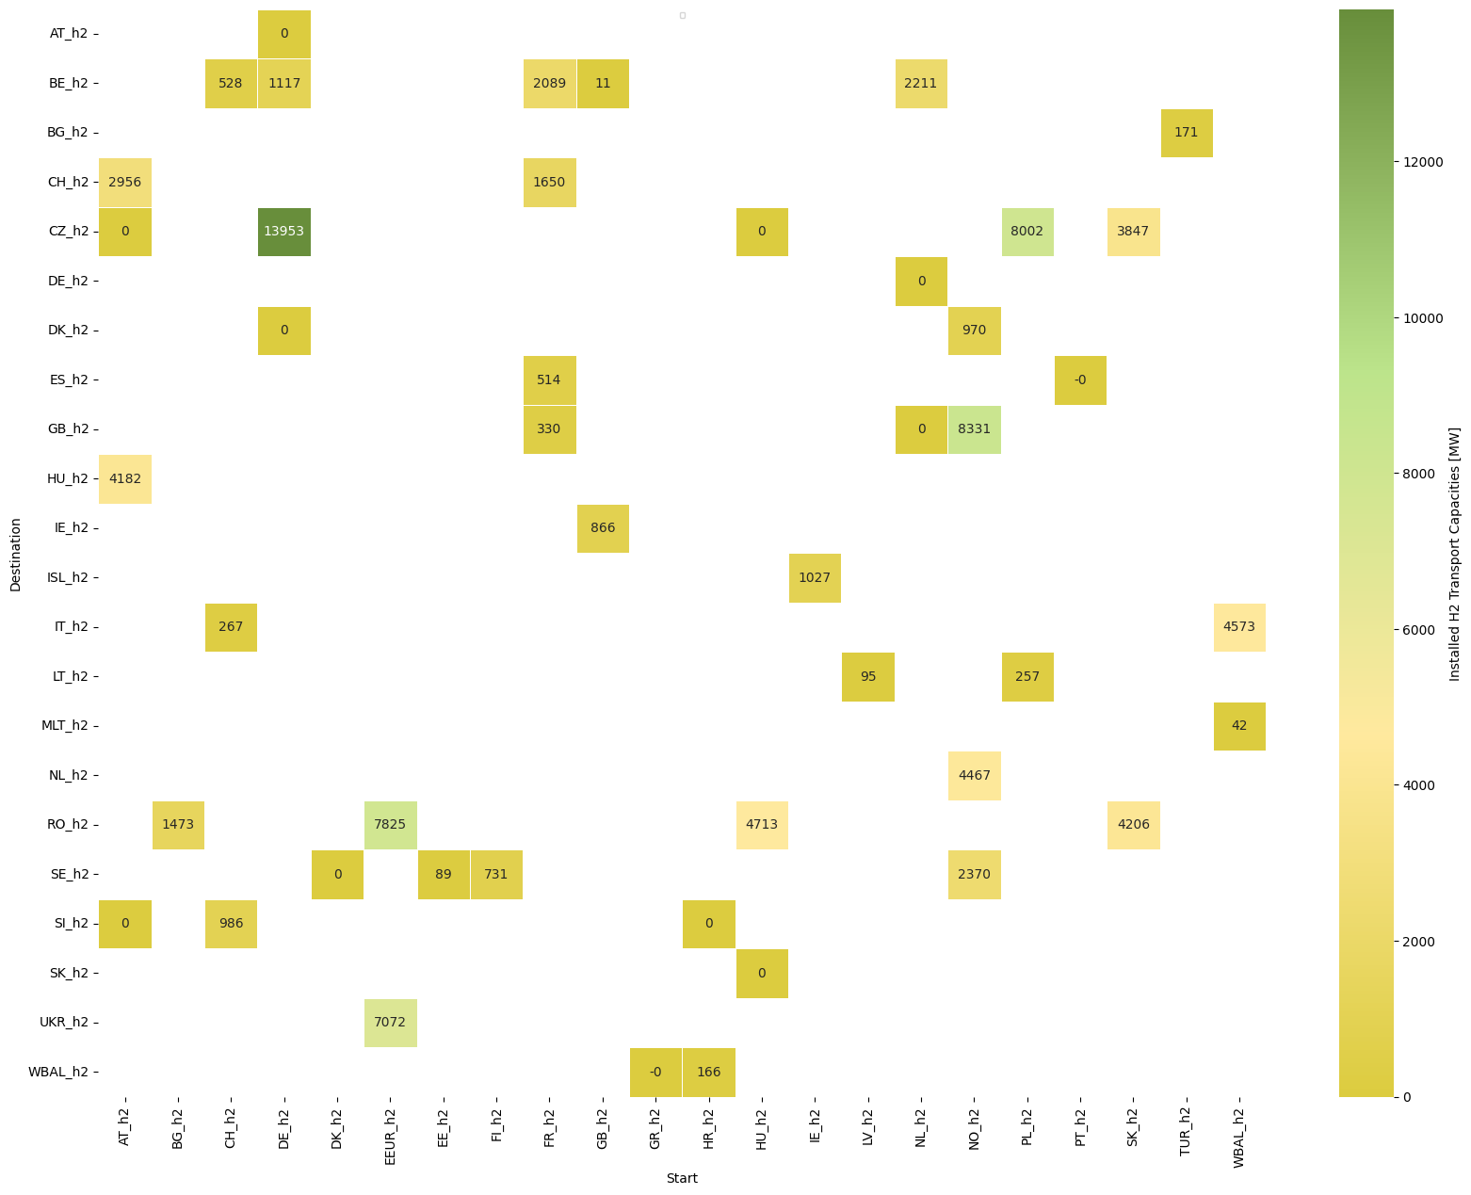
Installed transport capacity

Slide 33
WACC

Slide 34
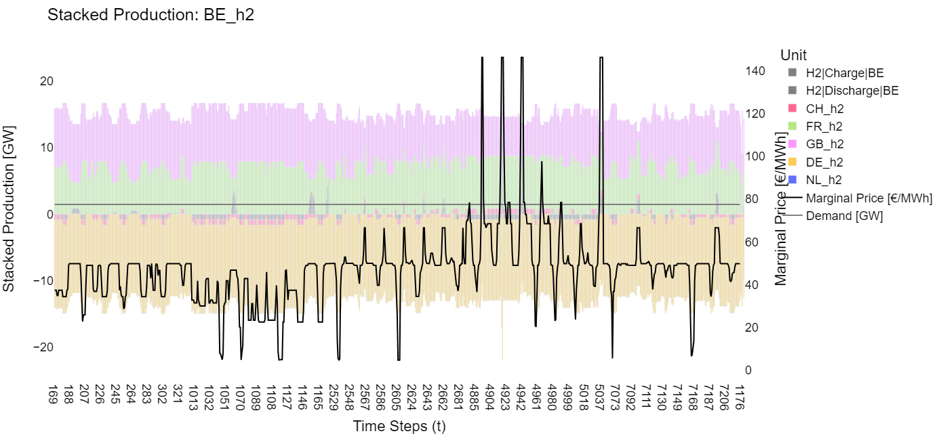
Hydrogen production and transit Belgium

